Slide 1


Crypto Market Analysis Prediction
Daniel Urdal
Asahi Cantu

Slide 2

Foreground – Crypto Currency market
Bitcoin – 2008. First Digital currency based on blockchain usage issued and published
2012-2014 Crypto currencies emergence based on bitcoin source code
2016 – 2017 General market adoption, several crypto-exchanges created
2017 – Crypto market boom and burst - [Binance company is created]
2018 – Present Market consolidation and adoption
Notes:
We can highlight the history of music after napster
https://www.theguardian.com/music/2019/may/31/napster-twenty-years-music-revolution
Music and piracy
https://visual.ly/community/infographic/entertainment/music-and-piracy

Slide 3

Foreground – Crypto currency exchanges
Massive adoption
High-Risk market
Market behavior faster than common stock
Susceptible to political and social changes
High profit potential
Fast technology adoption and implementation
24-7 operations
Notes:
We can highlight the history of music after napster
https://www.theguardian.com/music/2019/may/31/napster-twenty-years-music-revolution
Music and piracy
https://visual.ly/community/infographic/entertainment/music-and-piracy

Slide 4
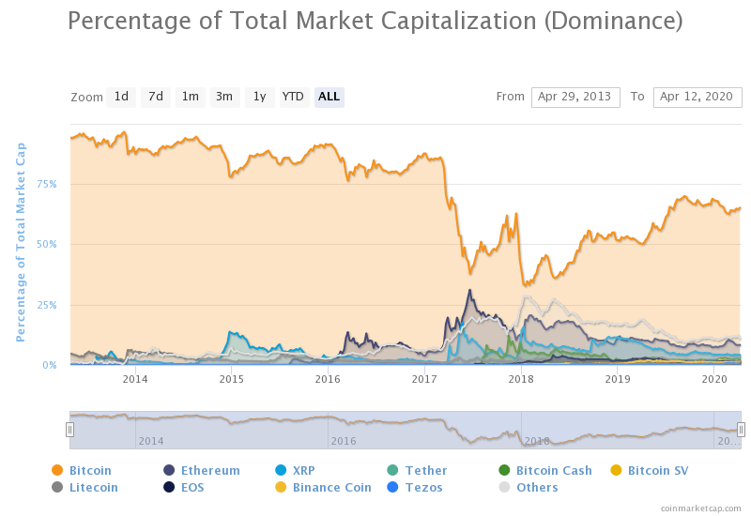
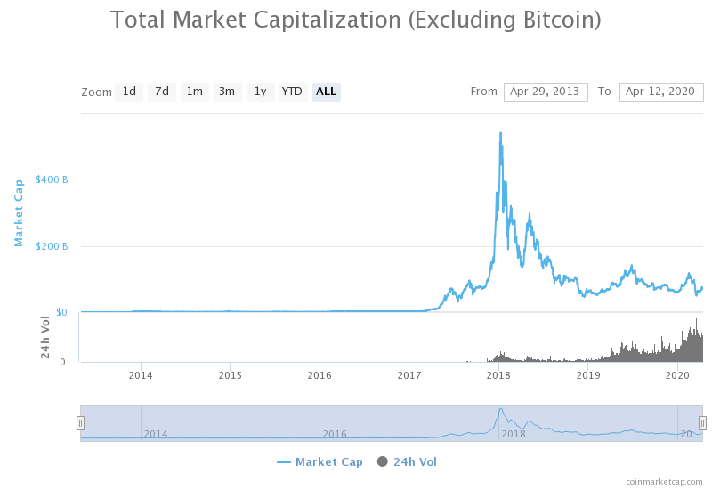
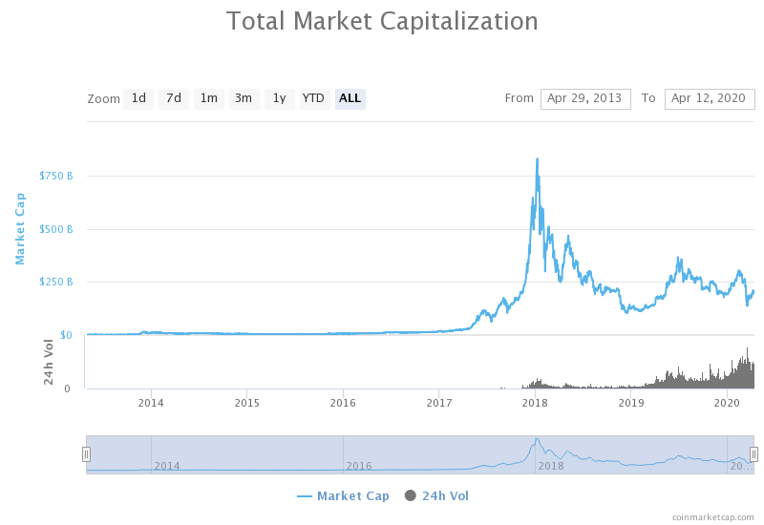
Foreground market - adoption
Consolidation of several cryptocurrencies exchange vs bitcoin
More stable prices, will have more accuracy on the market prediction analysis

Slide 5


Problem statement
The massive adoption and stabilization of the cryptocurrency prices are attracting new investors and consolidating technologies
High impact under social and political situations
Promising technologies to start creating financial security

Slide 6

Problem statement
By analyzing historical data of several cryptocurrencies and the news in a specific time, create a prediction model of the market with a high degree of certainty

Slide 7

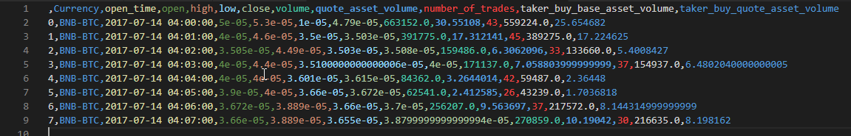
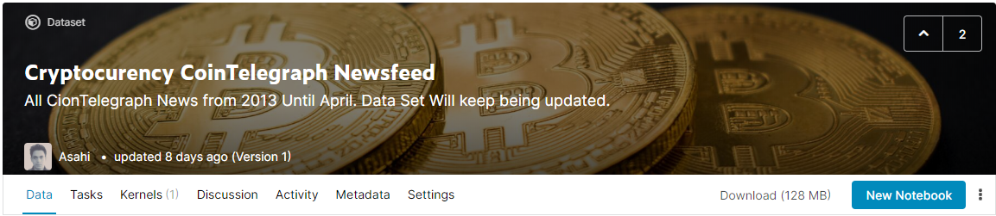
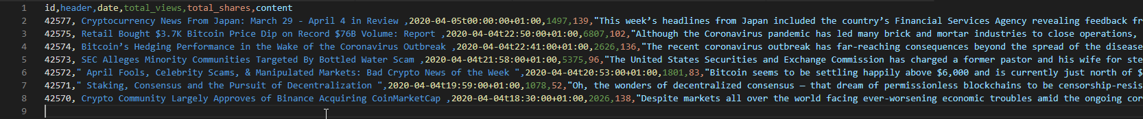
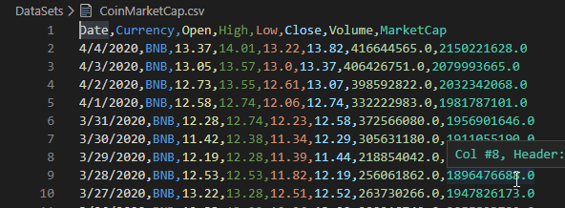
DataSet
Binance full history [https://www.kaggle.com/jorijnsmit/binance-full-history]
1 minute candlestick historic data from 2017 to present
~ 9 GB compressed dataset size (Parquet file)
768 crypto currency pairs
CoinTelegraph [https://cointelegraph.com]
Collected using Python scripts from 2013-2020
~130 MB containing news related only to cryptocurrency
https://www.kaggle.com/asahicantu/cryptocurency-cointelegraph-newsfeed
CoinmarketCap [https://coinmarketcap.com]
Global Market price of different cryptocurrencies
~ 1MB per cryptocurrency ticker for a 3 –year period

Slide 8

Related Works
Cryptocurrency Market Analysis
https://www.kaggle.com/taniaj/cryptocurrency-market-analysis
https://www.kaggle.com/taniaj/cryptocurrency-price-forecasting
Anticipating Cryptocurrency Prices Using Machine Learning (Laura Alessandretti , Abeer ElBahrawy, Luca Maria Aiello, Andrea Baronchelli)
https://www.hindawi.com/journals/complexity/2018/8983590/
https://www.kdnuggets.com/2018/11/keras-long-short-term-memory-lstm-model-predict-stock-prices.html

Slide 9



HADOOP Digital environment - Configuration
Master Node
Apache Spark
Slave Node
Slave Node
Slave Node

Slide 10

Algorithms
Market prediction model:
LSTM-RNN with TensorFlow - ~ 300 Epochs
News extraction algorithm – Python Script
Sentiment analysis model for untrained data
Predict how news affect prices via unsupervised learning
K-Means Clustering
NLP - Text Summarization

Slide 11
Expected results
Hadoop – Spark Cluster
Real time short-term price prediction for all cryptocurrencies
DataSet-ML models

Slide 12
Current challenges
Data storage requirements
Binance dataset: 9.37 GB with parquet files
Will need close to 70 GB on the cluster
No data set available for a news feed
Data set had to be created from scratch
Implementing newsfeed algorithm to fetch data from CoinTelegraph
Use of Deep Learning algorithms
Using TensorFlow with spark creates a challenge to distribute the resources, iterations to adjust the models
Unsupervised learning for unlabeled data
Newsfeed data is not labeled and requires advanced ML approaches to train, classify and label

Slide 13
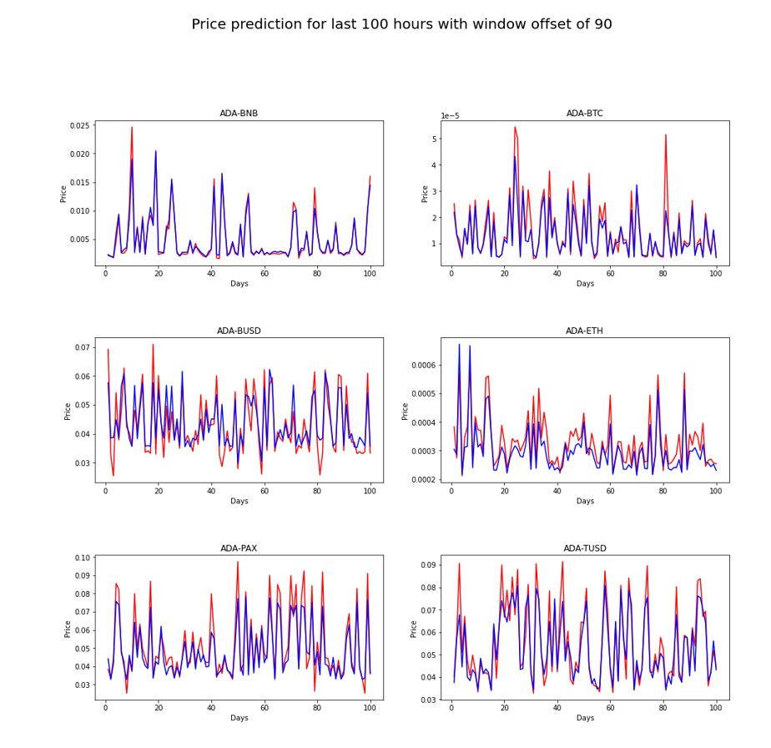
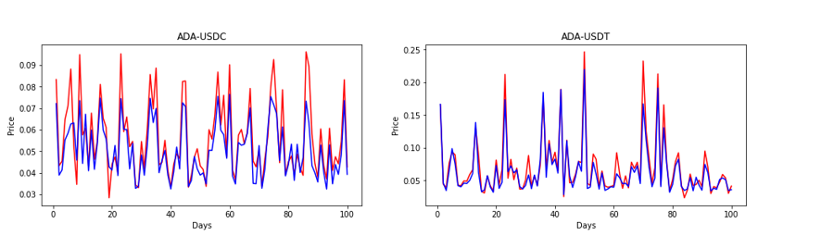
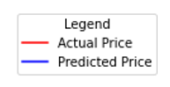
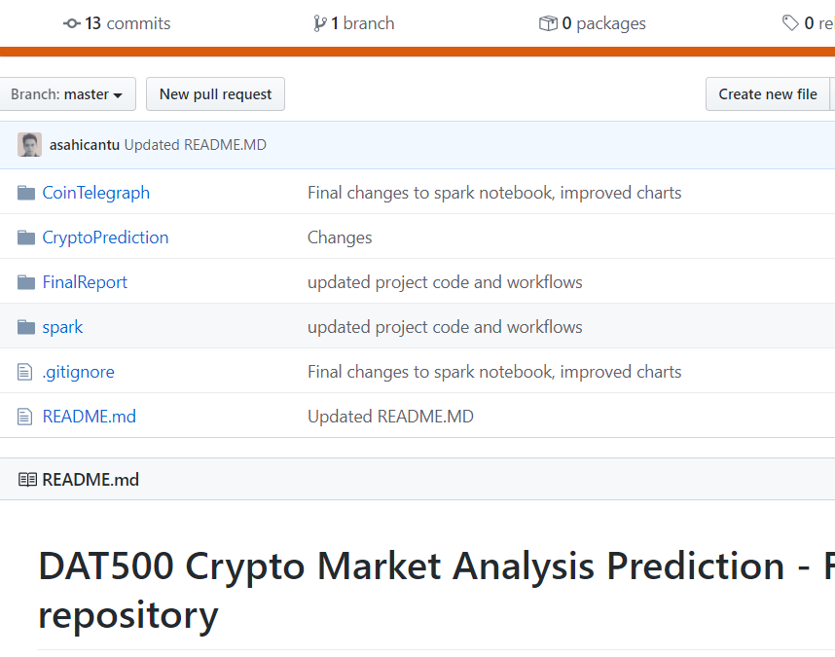
Current Results
ML Algorithm and trained models for cryptocurrency prediction
https://github.com/asahicantu/DAT500

Slide 14
Future Works
Merge Crypto Models with NewsFeed Classified Model:
sentiment analysis (Crypto subjects related to social networks)
Political and economical situation (News analysis)
Technological improvements and social adoption
Evolution analysis of cryptocurrency market by looking at Bitcoin prices and technological changes evolution (Hash rate increase, market capitalization, technological adoption, halving events…)

Slide 15
Contact
Daniel Urdal
d.urdal@stud.uis.no
Asahi Cantu
asahicantu@outlook.com
https://github.com/asahicantu

